Slide 1




BOURNE
INTELLIGENCE
Business Intelligence Market Research of IT & HR jobs in Australia

Slide 2
TABLE OF
CONTENT
01.
STATE WISE JOBS
02.
TOP 10 SKILLS (TOOLS) required
03.
SALARIES of the companies
04.
STATE WISE AVERAGE SALARY
05
CATEGORY WISE JOBS AVAILABLE
06
RECOMMENDATION

Slide 3

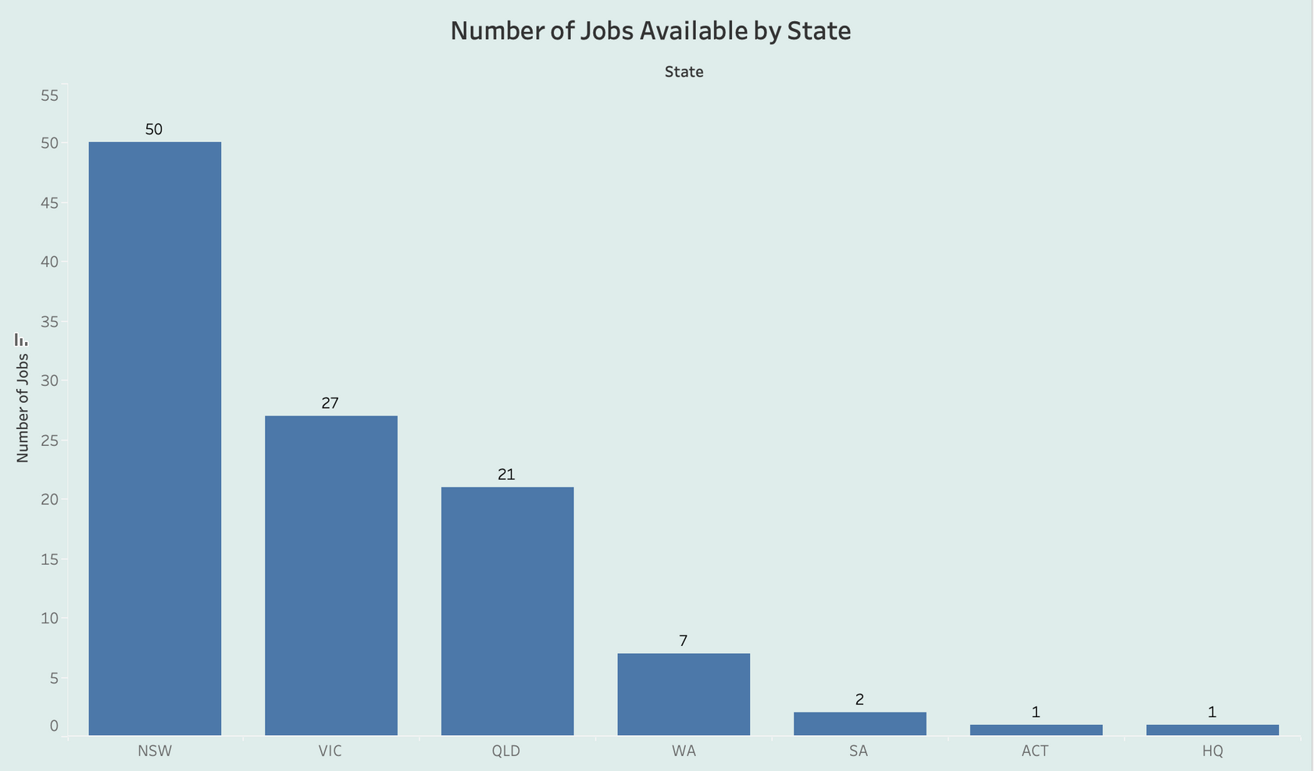

STATE WISE JOBS

Slide 4

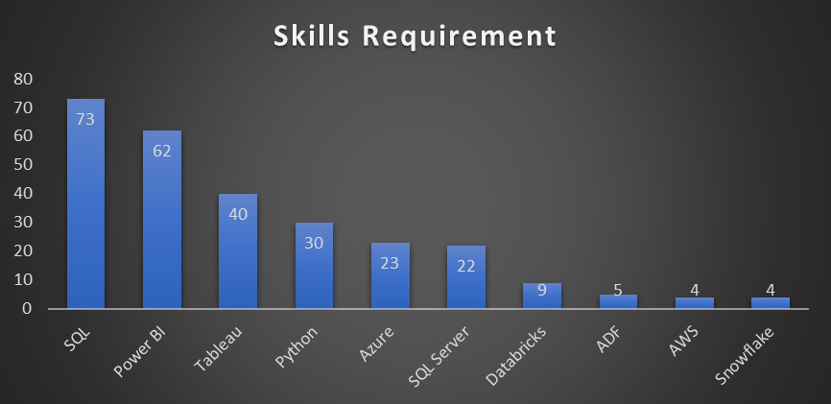

TOP 10 SKILLS (TOOLS) REQUIRED

Slide 5


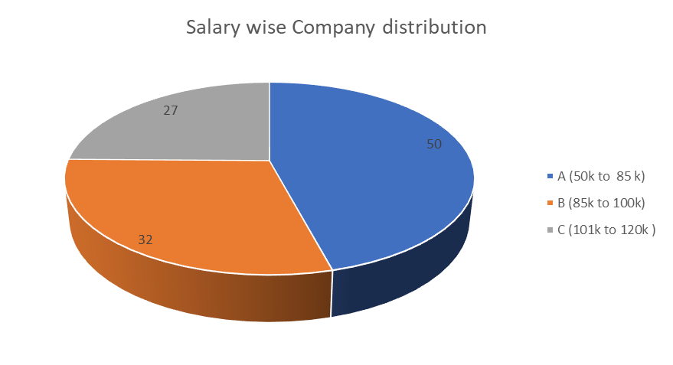


SALARIES OF THE COMPANIES

Slide 6

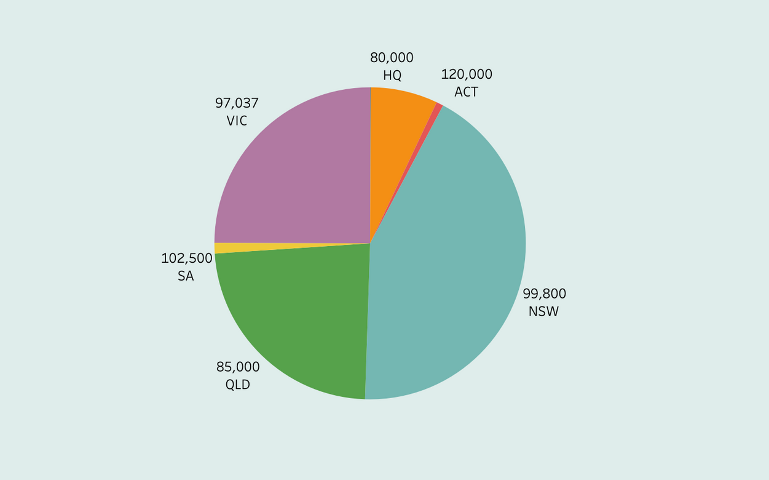
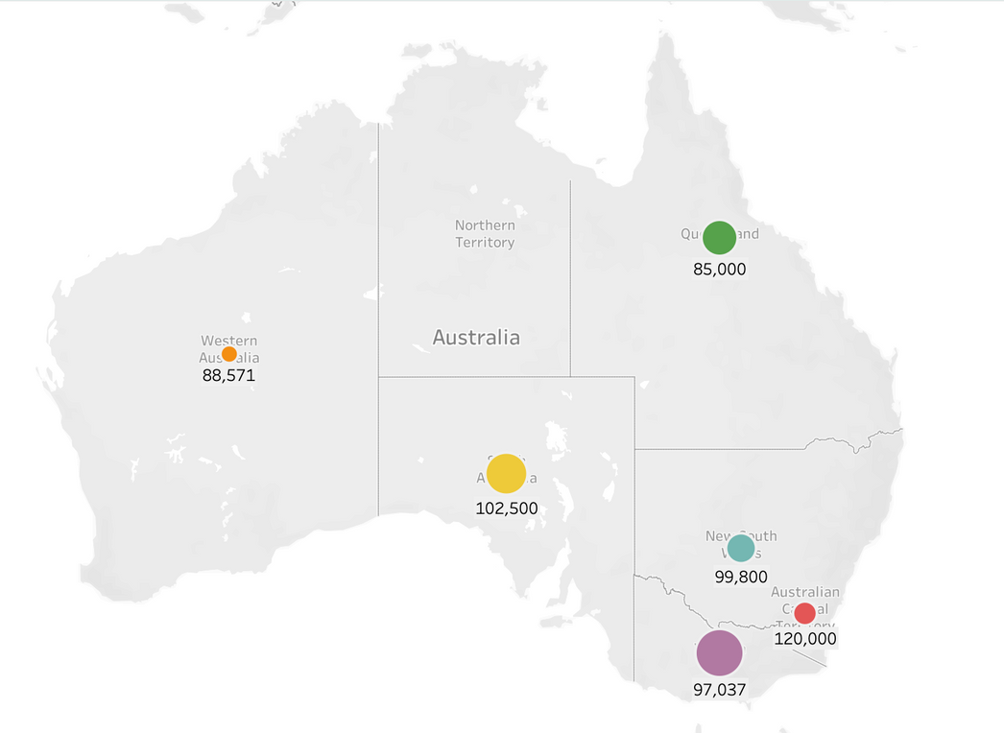


STATE WISE AVERAGE SALARY

Slide 7


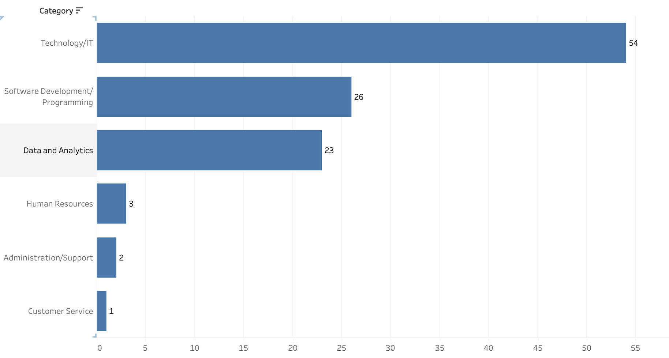
CATEGORY WISE JOBS AVAILABLE

Slide 8

RECOMMENDATION
Data and Analytics Category:
Consider exploring roles related to Power BI, Tableau, and SQL Server, as they are commonly requested skills.
Since Power BI is a prevalent tool, gaining expertise in it could open up various opportunities.
For more advanced roles like Data Architect or Data Engineering Lead, proficiency in Azure and other cloud platforms could be valuable.
Administration/Support:
SharePoint, SQL skills for roles like SharePoint Admin and Automation Developer. Admin roles need tech skills and tool understanding.
HR and Business Development/Sales:
Excel for HR, SQL/tools for Business Dev. CRM skills for Customer Management Leads.

Slide 9
Technology/IT Category:
Cloud computing and big data skills are in demand. Focus on roles that require expertise in AWS, Azure, and Snowflake.
Python is mentioned as a desired skill in several roles, indicating its importance in data analysis and engineering.
DevOps and automation skills (Terraform, Azure DevOps) are relevant for roles like Azure Platform Engineer and Senior Data Engineer.
Software Development/Programming Category:
SQL skills are consistently important across various roles.
Python is valuable for data analysis, engineering, and automation roles.
Experience with popular BI tools like Tableau and Power BI can enhance your profile.
Java and .NET skills can be leveraged for software development roles.

